Slide 1
SALVATION in the
APOSTOLIC FATHERS
Paul Lorenzen

Slide 2
WHO ARE THE APOSTOLIC FATHERS?
Collection of Writings – 16 Documents
  I Clement – Author unknown
  II Clement – Author unknown
  Letters of Ignatius, Bishop of Antioch to
    Ephesians
    Magnesians
    Trallians
    Romans
    Philadelphians
    Smyrnaeans
    Polycarp

Slide 3
WHO ARE THE APOSTOLIC FATHERS?
  Letter of Polycarp to the Philippians
  Martyrdom of Polycarp
  The Didache (Teaching of the Twelve Apostles)
  Epistle of Barnabas
  Shepherd of Hermas [not included in this study]
  Epistle to Diognetus
  Fragments of Papias

Slide 4
WHEN DID THEY WRITE?
What | When
Didache | 50-150
I Clement | 95
II Clement | 100-170
Ignatius | 110
Polycarp | 110
Papias | 130
Barnabas | 70-135
Shepherd of Hermas | 70-175
Diognetus | 150-225
Martyrdom of Polycarp | 155-67

Slide 5
WHAT TYPES OF WRITINGS?
Letters to Churches or Individuals
  I Clement – From Rome to Corinthians
  Ignatius – From Bishop to six churches and one bishop
  Polycarp – From Polycarp to the Church at Philippi
  Martyrdom of Polycarp – From Smyrna to Philomelium
Church Manual
  Didache – Διδαχὴ - Teaching of the Twelve Apostles
Doctrinal Instruction
  Papias – 5 volumes Expositions of the Sayings of the Lord
  Barnabas – Homily or doctrinal treatise
  Shepherd of Hermas – Extended allegory
Apology/Sermon
  Diognetus – evangelistic apology to political leader
  II Clement – sermon to believers

Slide 6
WHY THIS STUDY?
Something Missing From Many of These Writings
  Jesus viewed as an “example” rather than “Savior”
  Cross of Jesus overlooked or minimized
  “Grace” seems to have disappeared from message
Salvation References Appear to be Works Oriented
  Salvation is result of human effort
  Assurance of salvation missing
Purpose of This Study
Determine the Doctrine of Salvation [Soteriology] in the Second Century of the Church

Slide 7
SALVATION TERMINOLOGY USED
Source of the Word Group – Theological Dictionary of the New Testament
Five Greek Terms in the Word Group
  σώζω – sozo - save
  σωτηρία – soteria - deliverance
  σωτήρ – soter - savior
  σωτήριος – soterios - salvation
  διασῴζω – diasozo - save

Slide 8
METHODOLOGY OF THE STUDY
Establish a Base Line Doctrine
Create a Concordance of the Greek Terms
Analyze Each Occurrence in Each Document
Extract a “Theology” of Salvation of Each Author
Summarize the Conclusions

Slide 9
1. ESTABLISH BASELINE THEOLOGY
Ephesians 2:8-9
For by grace you have been saved through faith; and that not of yourselves, it is the gift of God; not as a result of works, so that no one may boast. [New American Standard Bible]

Slide 10
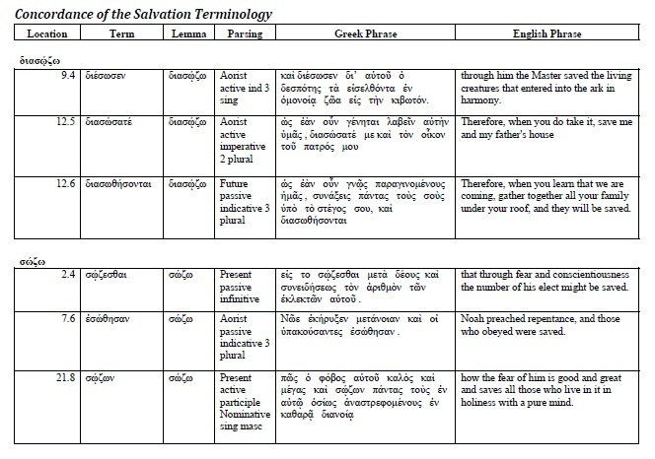
2. CREATE THE CONCORDANCE

Slide 11
3. ANALYZE EACH OCCURRENCE
EXAMPLE: I Clement – Savior [σωτήρ]
The term Savior [σωτήρ] is found only once in First Clement, in 59:3. This is in the context of the long prayer referenced earlier and describes God as the "Savior." While there are references in the prayer to Jesus Christ, it appears that the reference in this context to Savior is not to Jesus Christ but rather to God the Father. The primary verb in this sentence is found back at the beginning of verse three where it says "Grant us, Lord, . . ." [δὸς ἡμῖν, κύριε]. Toward the end of verse 4 Clement refers to "Jesus Christ, your beloved Servant." Thus, since he indicates that Jesus is the beloved Servant of the one addressed, the one addressed must be God the Father. In verse 4 it then describes the one petitioned, God the Father, as "the 'Savior of those in despair'." Thus, it is clear that this use of σωτήρ does not refer to Jesus Christ as Savior but to God the Father as Savior. This is a generic reference to God as Savior and is in the context of recognizing the magnificence of God in praise and adds nothing to our understanding of Clement's view of the individual believer's salvation. [Page 23]

Slide 12
4. EXTRACT A “THEOLOGY”
First Clement Soteriology (Theology of Salvation)
In our search to understand the soteriology reflected in First Clement and comparing that with the soteriology found in Ephesians 2:8-9, we are disappointed in what we have found. Most of the occurrences of our salvation terminology do not have significant personal spiritual content. Those that do appear to present an understanding of salvation as that which is achieved rather than received. The believer is given "grace" but that grace is the example and teaching of Jesus in his ministry and death on the cross. That "grace" enables the believer to have his eyes opened and his knowledge increased so that, properly motivated, he will conform his behavior with proper repentance and penitence that will result in his achieving a future salvation. This might be excused to a certain extent by remembering the purpose of First Clement - to urge a proper ecclesiastical structure in the Corinthian church by restoring the church leadership and restore unity with the body of that church. With this objective, we would not expect to see a crystal clear presentation of the gospel of grace. However, those glimpses we are given into Clement's understanding present an understanding of soteriology that could easily be endorsed by Pelagius and others in the following centuries who ascribe salvation to the believer's conduct and efforts, at least in maintaining, if not in obtaining eternal salvation. [Page 26]

Slide 13
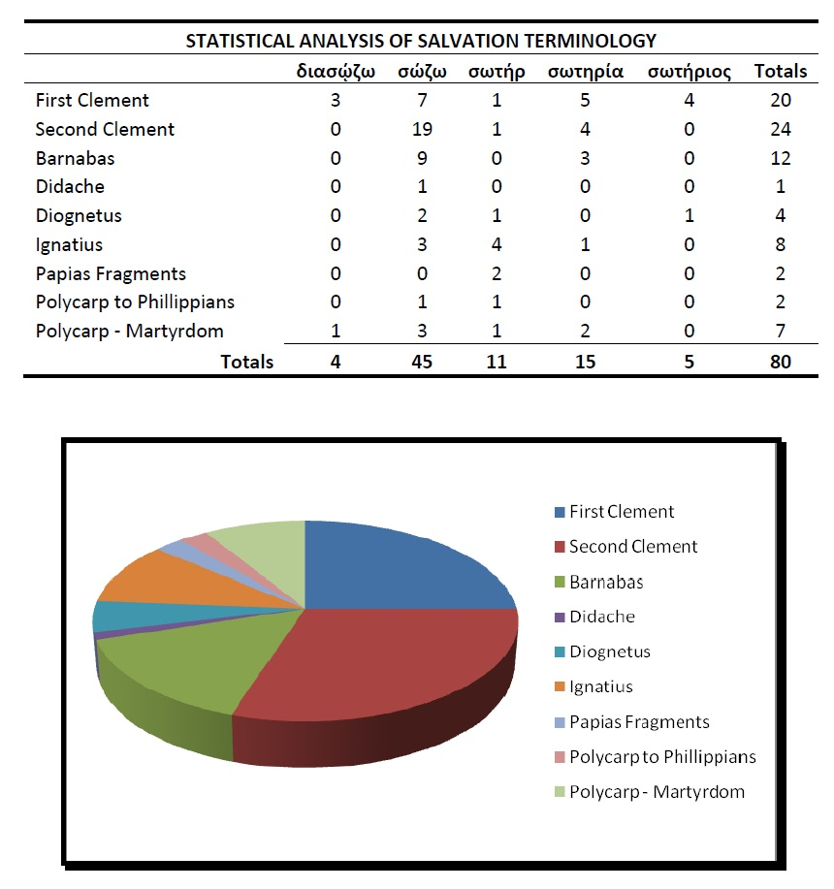
5. RESULTS OF THE STUDY

Slide 14
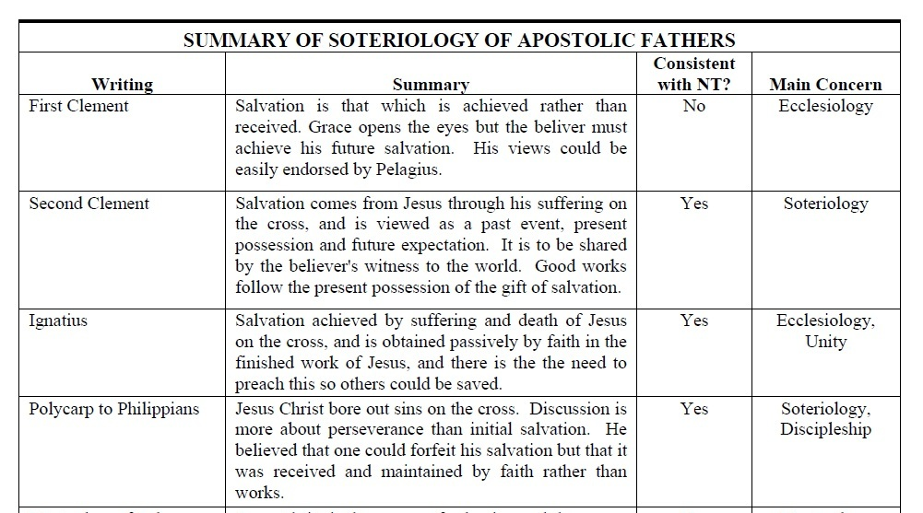
RESULTS OF THE STUDY

Slide 15
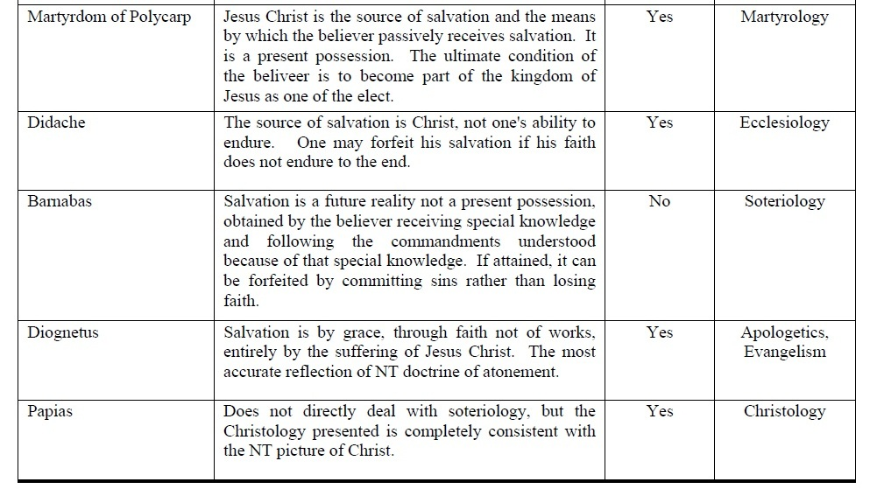
RESULTS OF THE STUDY

Slide 16
RESULTS OF THE STUDY
Barnabas & First Clement – Very Disappointing
Second Clement & Diognetus – Crystal Clear Soteriology
Other Documents – Soteriology is not clear but the objectives of the document did not deal directly with this doctrine

Slide 17
RESULTS OF THE STUDY
CONCLUSION OF THE PAPER [pg 122-23]
“Finally, it is encouraging to see that through the early centuries of the church, the message did survive even though some even within the church did not fully understand, or were not able to clearly communicate, the New Testament message. It is also especially encouraging that, although the Epistle of Barnabas circulated for centuries actually incorporated within some of the collections of what eventually became the New Testament canon, the church, in its wisdom, eventually rejected Barnabas as not being worthy of inclusion in the accepted canon.

Slide 18
RESULTS OF THE STUDY
“I am reminded as I close the conclusion of this paper of an experience I had as an associate staff member in a Nazarene Church in Sparks, Nevada years ago. On a Wednesday evening, while trying to teach a group how to use the “diagnostic questions” in Evangelism Explosion, by D. James Kennedy, I decided to demonstrate by asking the questions of an old, long-time, board member of the church, thinking that he would give the correct answer and demonstrate how well the questions worked.

Slide 19
RESULTS OF THE STUDY
“I asked the first question: ‘Have you come to the place in your spiritual life where you know for sure that if you were to die tonight you would go to heaven?’ He answered with a resounding ‘yes.’ So far so good.
“I asked the second question: ‘Suppose you were to die tonight and stand before God and he were to ask you, ‘why should I let you into my heaven?’ what would you say?’ His answer was a confident statement that he had been a member of the Nazarene Church for 60 years, paid his tithe, etc., etc., etc., and he was confident that he was good enough! [Not the right answer!]

Slide 20
RESULTS OF THE STUDY
“I rephrased the question several times trying to solicit the correct answer of Jesus dying for his sins and his trust in Jesus alone for his salvation. Try as I may, I could not get him to say anything about what Jesus had done for him on the cross or that he was relying on Jesus to make him acceptable to God. After about five minutes, I finally gave up and tried to salvage the presentation in another way.

Slide 21
RESULTS OF THE STUDY
“The old Nazarene board member sometime in his past probably had experienced a true saving spiritual connection with Jesus. He just had no capacity to communicate that when given the opportunity. Perhaps that’s the best we can say about some of the writers of the Apostolic Fathers documents. Thankfully, there are others, like Diognetus and Second Clement, who were able to write with clarity of the gospel of grace.
Thankfully, the church preserved their writings.

